Slide 1


STATISTIC 3202 MIDTERM 2
Linlin Xia

Slide 2

preview
$\hat{}θ$ means estimator for a parameter $θ$.
$\hat{}θ$ is unbiased if E($\hat{}θ$) = $θ$.
$\hat{}θ \text{is} \text{consistent} \text{if} \lim_{n→∞}{P{\left(\left|\hat{}θ −θ\right|≤ ε\right)=1}^{}}$
$\hat{}θ$ is sufficient if $\hat{}θ$ contains all information about the observed data.

Slide 3

SUFFICIENCY
$\hat{}θ$is sufficient if $\hat{}θ$contains all information about the observed data.
没有其他来自同样样本的统计量能够比充分统计量提供更多关于位置参数的信息

Slide 4
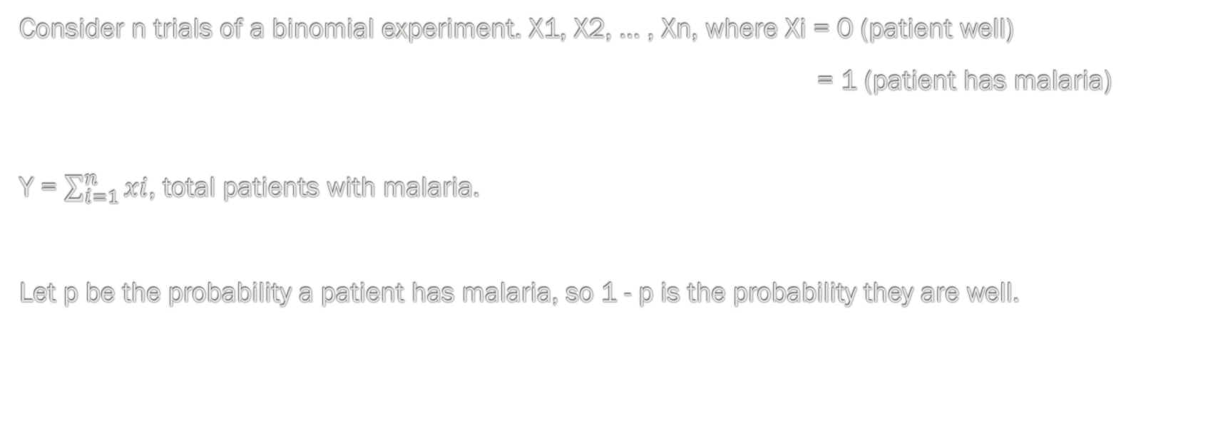
EXAMPLE 1
Consider n trials of a binomial experiment. X1, X2, … , Xn, where Xi = 0 (patient well)
= 1 (patient has malaria)
Y = $\sum_{i=1}^{n}{xi}$, total patients with malaria.
Let p be the probability a patient has malaria, so 1 - p is the probability they are well.

Slide 5
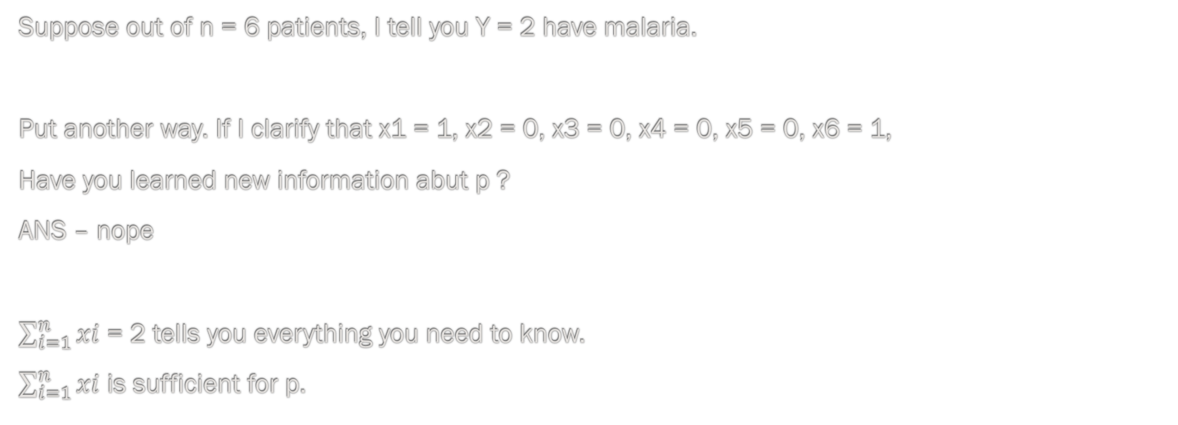
EXAMPLE 1
Suppose out of n = 6 patients, I tell you Y = 2 have malaria.
Put another way. If I clarify that x1 = 1, x2 = 0, x3 = 0, x4 = 0, x5 = 0, x6 = 1,
Have you learned new information abut p ?
ANS – nope
$\sum_{i=1}^{n}{xi}$ = 2 tells you everything you need to know.
$\sum_{i=1}^{n}{xi}$ is sufficient for p.

Slide 6
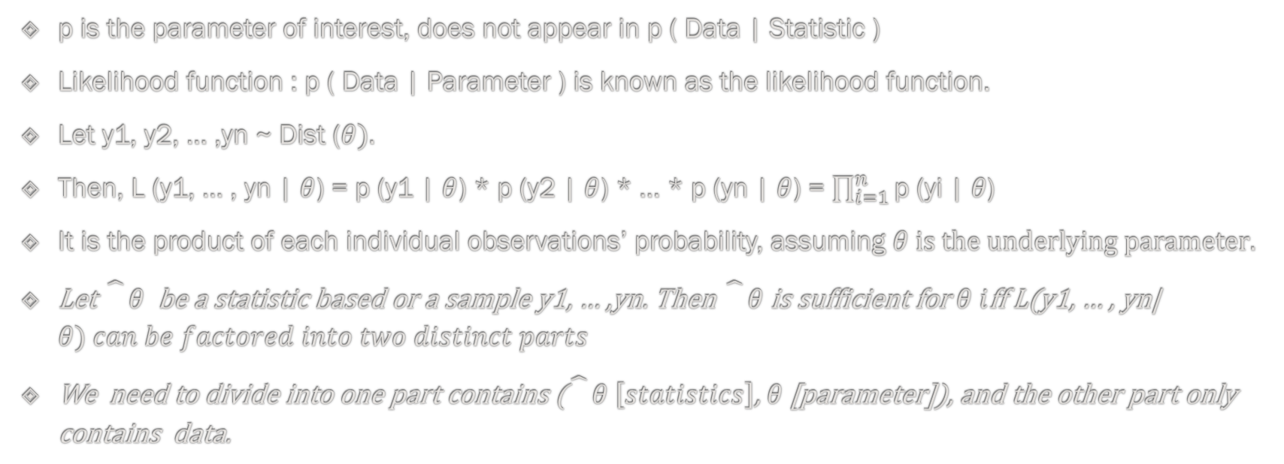
KEY : p
p is the parameter of interest, does not appear in p ( Data | Statistic )
Likelihood function : p ( Data | Parameter ) is known as the likelihood function.
Let y1, y2, … ,yn ~ Dist ($θ).$
Then, L (y1, … , yn | $θ$) = p (y1 | $θ$) * p (y2 | $θ$) * … * p (yn | $θ$) = $\prod_{i=1}^{n}{\text{p}\text{ (}\text{yi}\text{ | }θ\text{)}}$
It is the product of each individual observations’ probability, assuming $θ is the underlying parameter.$
Let $\hat{}θ$ be a statistic based or a sample y1, … ,yn. Then $\hat{}θ$is sufficient for $θ i$ff L(y1, … , yn| $θ) can be factored into two distinct parts$
We need to divide into one part contains ($\hat{}θ \left[statistics\right]$, $θ$[parameter]), and the other part only contains data.

